Slide 1


TOC
ReaderWriterLockSlim
SemaphoreSlim

Slide 2
ReadWriteLockSlim

Slide 3
Purpose:
The ReaderWriterLockSlim class provides a mechanism for synchronizing access to shared resources between multiple threads. It allows multiple readers to access the resource simultaneously, but only one writer can access the resource at a time. This is a more efficient approach than using a simple lock statement for scenarios where many readers but fewer writers are expected.

Slide 4
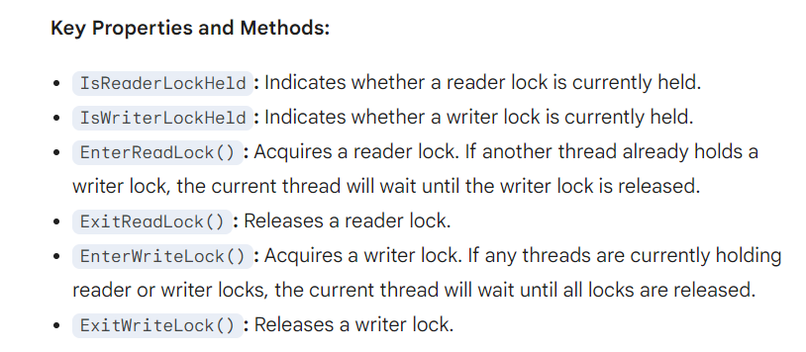

Slide 5
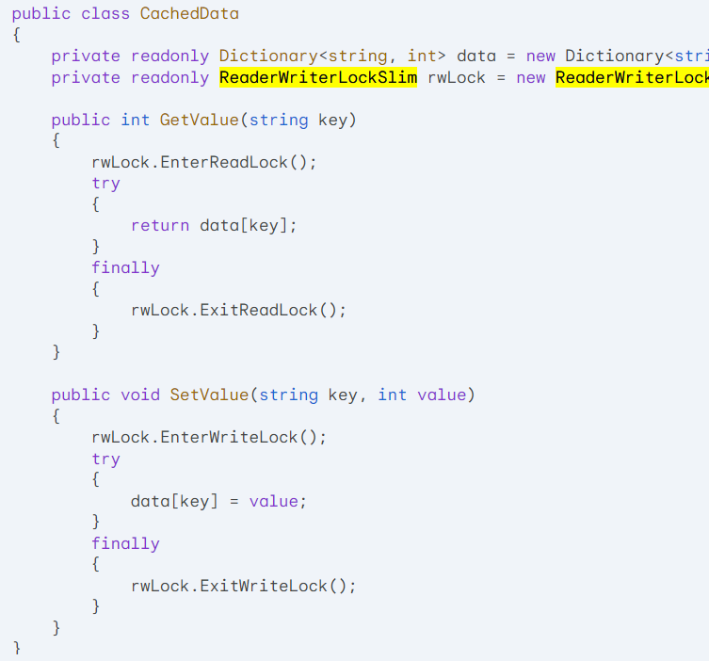

Slide 6
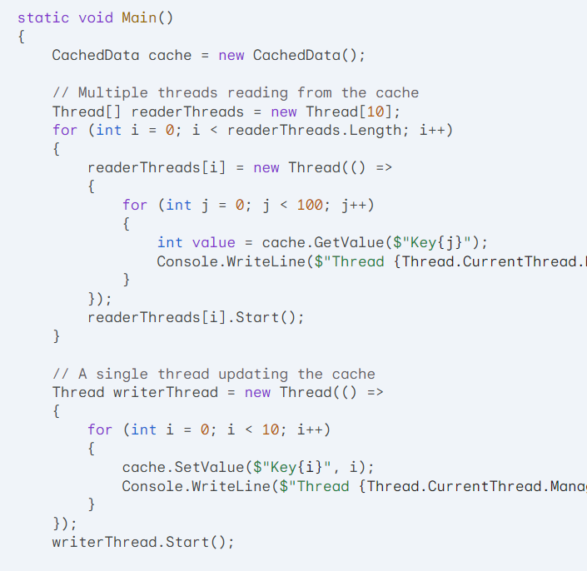

Slide 7
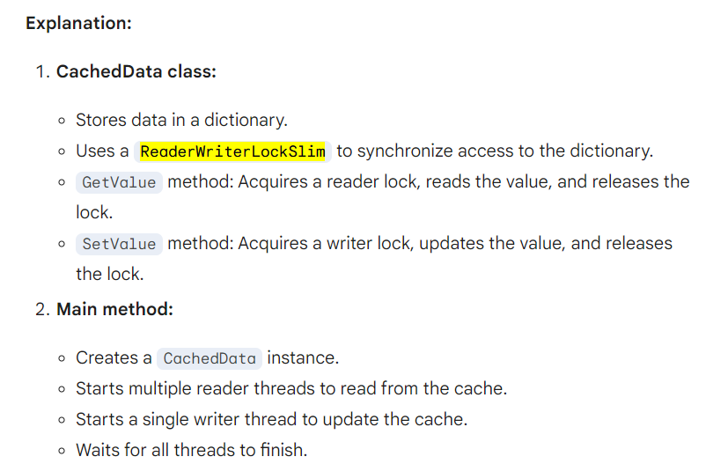

Slide 8
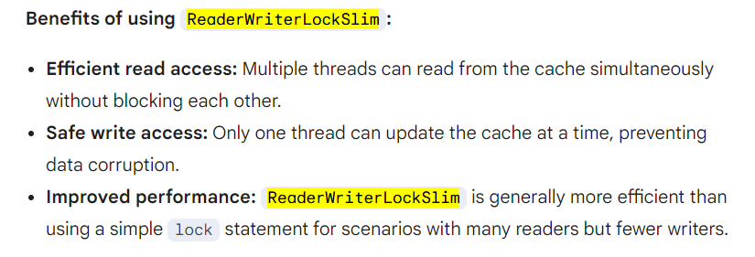

Slide 9
SemaphoreSlim

Slide 10
SemaphoreSlim:
A user-level object that uses a counter to control access to a shared resource.
The initial number of available permits is specified when the semaphore is created.
A thread can acquire a permit by calling Wait(). If no permits are available, the thread will wait until a permit is released.
A thread can release a permit by calling Release().
SemaphoreSlim is generally faster than Semaphore due to its user-level implementation, making it suitable for performance-critical scenarios.

Slide 11
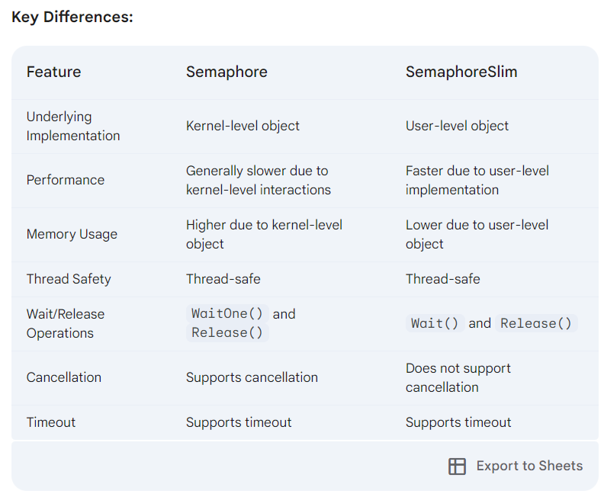

Slide 12
CountdownEvent

Slide 13
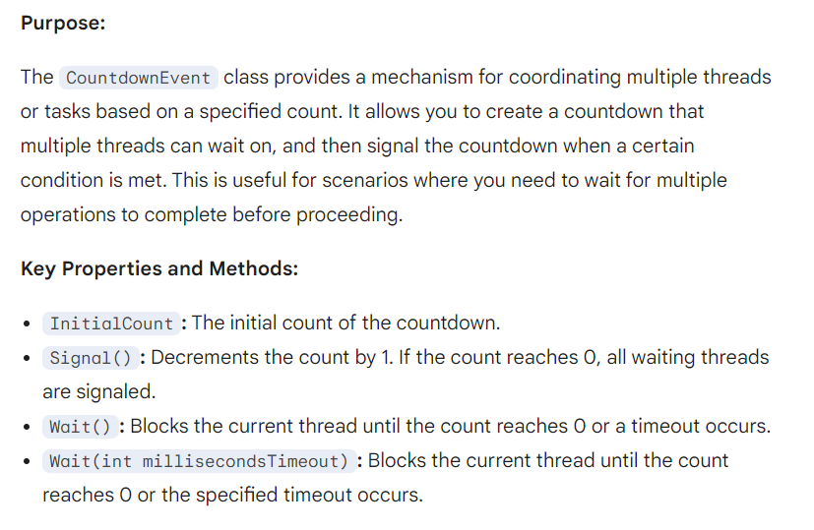

Slide 14
Real-time Scenario for CountdownEvent
Scenario: A distributed application with multiple worker nodes. You want to trigger a global operation (e.g., a database backup) only after all worker nodes have completed their current tasks.

Slide 15
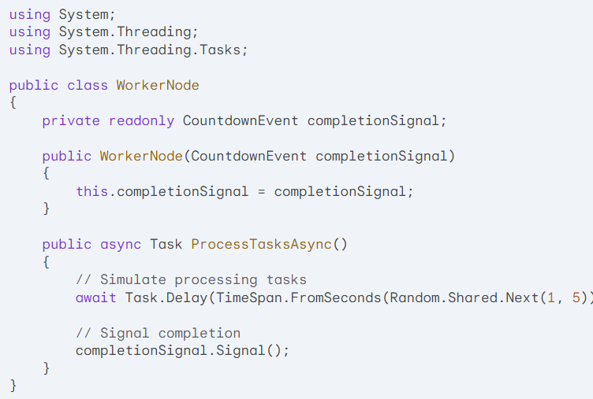

Slide 16
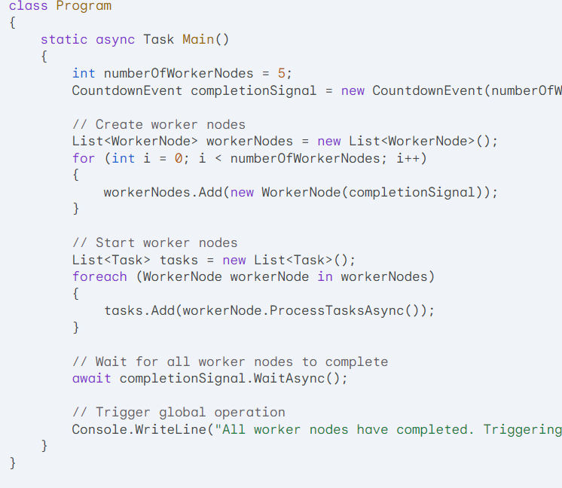

Slide 17
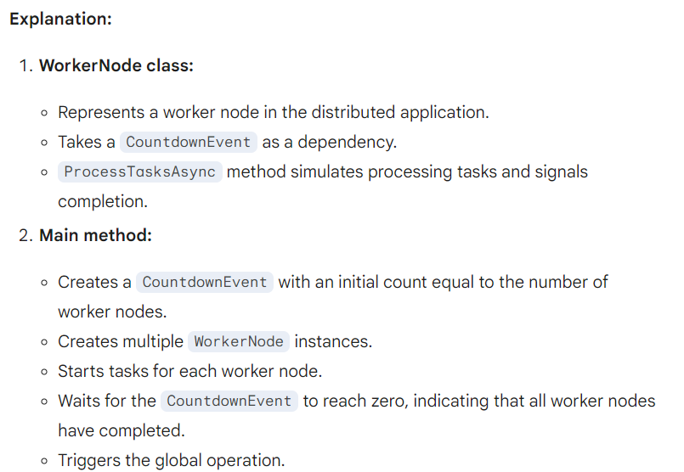

Slide 18
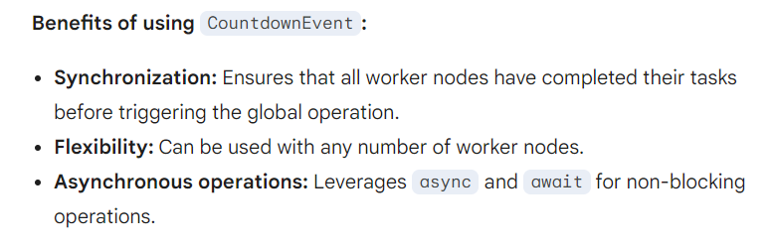

Slide 19
Barrier

Slide 20
Purpose:
The Barrier class provides a mechanism for synchronizing multiple threads or tasks at a specific point in their execution. It allows you to create a barrier that multiple threads can wait on, and then release all waiting threads at once when a specified number of threads have reached the barrier. This is useful for scenarios where you need to ensure that all threads have completed a certain step before proceeding.

Slide 21
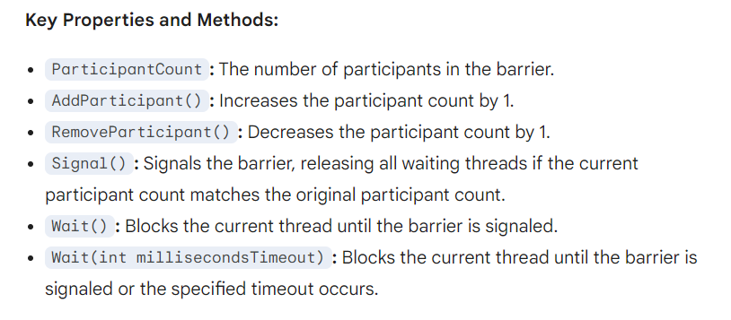

Slide 22
Another Example: Parallel Image Processing
Scenario: A large image processing application that needs to process different regions of an image in parallel. However, certain processing steps require the results from other regions, so synchronization is necessary.

Slide 23
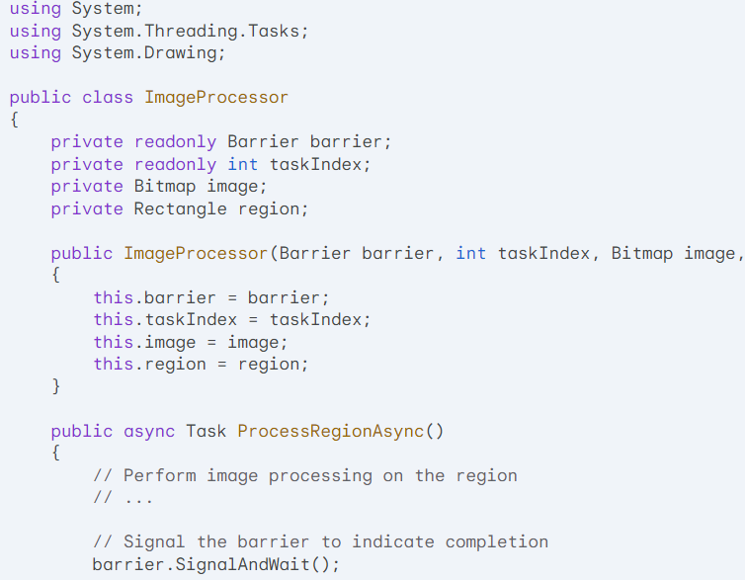

Slide 24
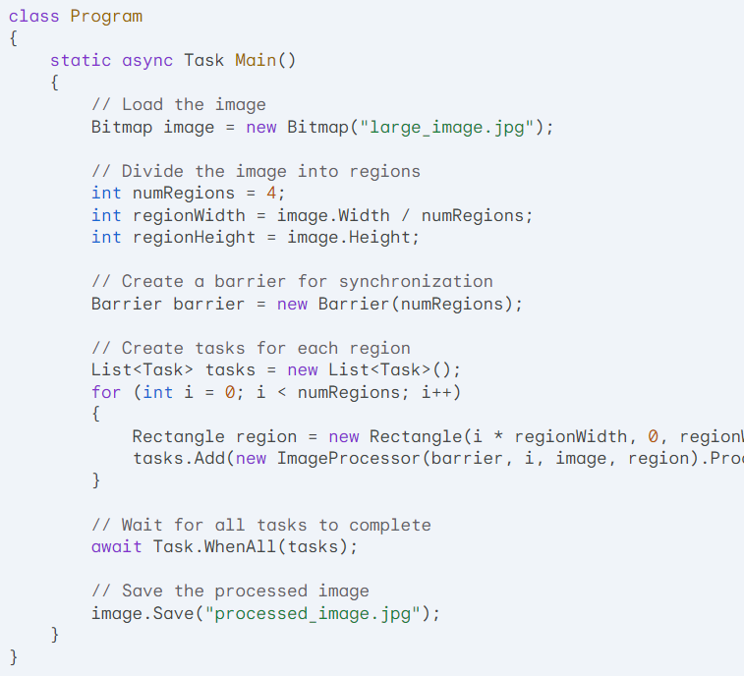

Slide 25
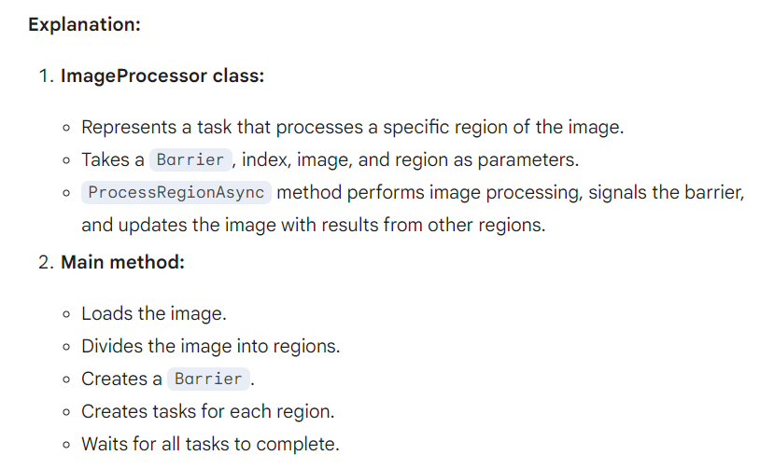

Slide 26
Key points:
The Barrier ensures that all regions have been processed before updating the image with the results from other regions.
This approach allows for efficient parallel image processing while maintaining the correct order of operations.
The Barrier can be used in various image processing scenarios, such as edge detection, filtering, and feature extraction.

Slide 27
CountdownEvent:
Purpose: Used to coordinate multiple threads or tasks based on a specified count.
Mechanism: Tracks a count and signals all waiting threads when the count reaches zero.
Use cases:
Waiting for multiple asynchronous operations to complete before proceeding.
Implementing a "cancellable" operation where a certain number of tasks must finish before cancellation is allowed.
Barrier:
Purpose: Used to synchronize multiple threads or tasks at a specific point in their execution.
Mechanism: Creates a barrier that all participants must reach before proceeding.
Use cases:
Implementing parallel algorithms where multiple threads must wait for each other at specific points.
Coordinating multiple stages of a pipeline or workflow.

Slide 28
Key differences:
Count vs. Participants: CountdownEvent tracks a count, while Barrier tracks participants.
Signal mechanism: CountdownEvent can be signaled multiple times, while Barrier is typically signaled only once per participant.
Wait behavior: CountdownEvent waits for the count to reach zero, while Barrier waits for all participants to reach the barrier.

